Slide 1
Computer Network
Transmission Mode

Slide 2
Transmission mode
Transmission mode means transferring of data between two devices. It is also known as communication mode. Buses and networks are designed to allow communication to occur between individual devices that are interconnected.

Slide 3

Types of Transmission Mode
There are three types of transmission mode:-
Simplex Mode
Half-Duplex Mode
Full-Duplex Mode

Slide 4

Simplex Mode
In Simplex mode, the communication is unidirectional, as on a one-way street. Only one of the two devices on a link can transmit, the other can only receive. The simplex mode can use the entire capacity of the channel to send data in one direction.
Example: Television, Radio, Keyboards and Monitors.

Slide 5
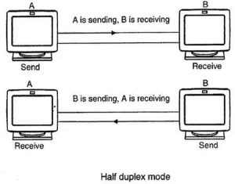
Half-Duplex Mode
In half-duplex mode, each station can both transmit and receive, but not at the same time. When one device is sending, the other can only receive, and vice versa. The half-duplex mode is used in cases where there is no need for communication in both direction at the same time.
Example: Walkie-Talkie

Slide 6

Full-Duplex Mode
In full-duplex mode, both stations can transmit and receive simultaneously. Full-duplex mode is used when communication in both direction is required all the time. The capacity of the channel, however must be divided between the two directions.
Example: Telephone, Mobile.

